Slide 1
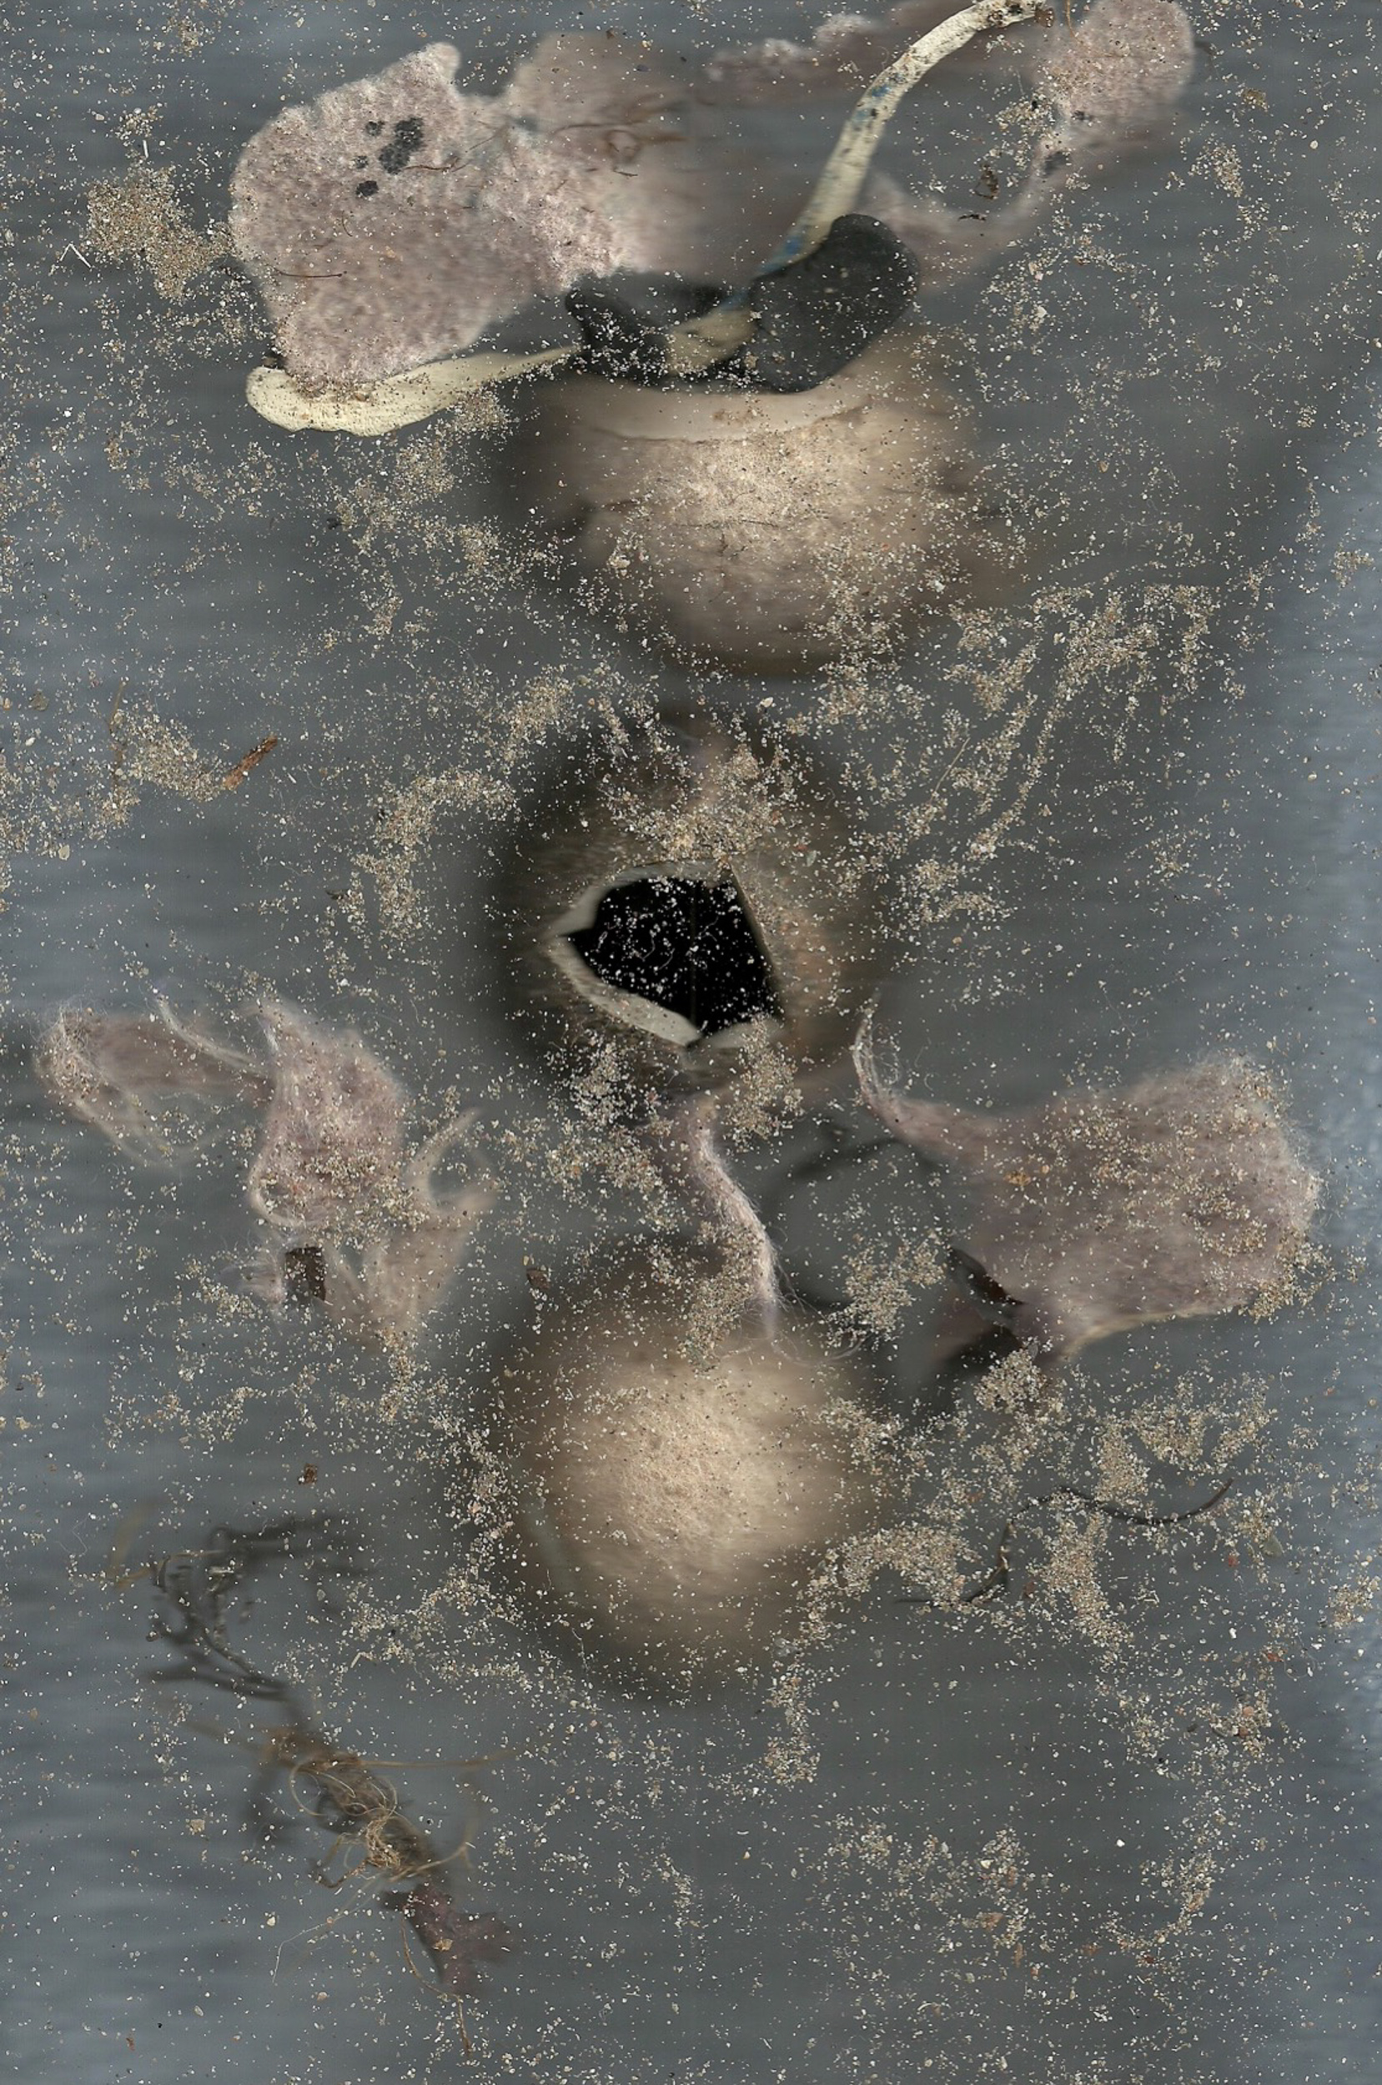
No Camera Photography
Sarah Newton
5th August 2018

Slide 2
Health and Safety
Do not work near food or drink.
Wear an apron and old clothing.
Use gloves, particularly when using a pinhole camera and making cyanotypes as the processing involves chemicals.
Do not work near food or drink.
Wash hands thoroughly when processing has been completed.
If splashed with a chemical solution:
  eyes= clean water at least 15 minutes and seek medical advice
  skin= soap and water at least 5 minutes seek medical advice as appropriate
  inhalation= move outside to fresh air
  injury= use first aid kit and seek medical advice as appropriate.

Slide 3
Pinhole Photography
Infinite depth of field. With one eye and no glasses look through a thin sheet of opaque material. Hold one finger a few inches away from your face. Both the finger and the background should be in focus.
Seeing what will happen. Replace back of pinhole camera with tracing paper. In a darkened room point the pinhole side of the camera to a strong source of light. The image you see on the tracing paper will be upside down and back to front.
Making a negative image. In red light load film at the back of the camera with shiny side facing towards the pinhole at the front. Expose to light for times according to conditions(e.g. bright sunlight 15 seconds….interior room light 4-5 minutes). Remove film in red light and process in trays. Fist the left tray =developer film face down 10 secs then turn over and watch until right 1-2 minutes. Second middle tray= fixer, film face down for 10secs than turn over and watch while moving it around for about 2 minutes. Third Right tray=water, wash for 1-2 mins. Set out to dry. It will be a negative image.
Making a positive image. Use red light. Place new film shiny side up on top of pinhole box. Put the negative face down on top of it. Put acrylic sheet on top of them, held together with the elastic bands. Hold towards desk light at least 1.5 metres away. Switch on the desk light for 2-3 seconds. Alternatively hold box towards bright sunlight 4-5 seconds. Then in red light develop, fix, wash and dry the new sheet of film.
Making a positive image another way. Scan the negative image into the computer. Open photoshop, go to edit and invert, then save and print.

Slide 4
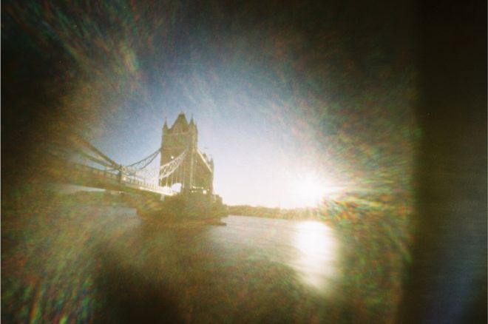
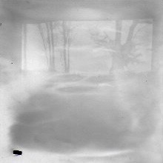
William Lewis Tower Bridge on a bright sunny day taken using a matchbox camera, 2018
View from my garden

Slide 5
Cyanotypes
Design. Set out your items on an A4 sheet of paper and note their relative positions.
Decide whether to combine the items with a negative image.
Layers:
      Top acrylic sheet
      Your items
      Sun print paper blue side up
      Cardboard
Expose to sunlight until paper is almost white. Be careful not to over expose.
Rinse the paper in water keeping it moving for about a minute.
Dry sun paper on a flat surface.
Scan and save the image on the computer.
Use a program to crop, and adjust contrast and colour.
Print the image.

Slide 6
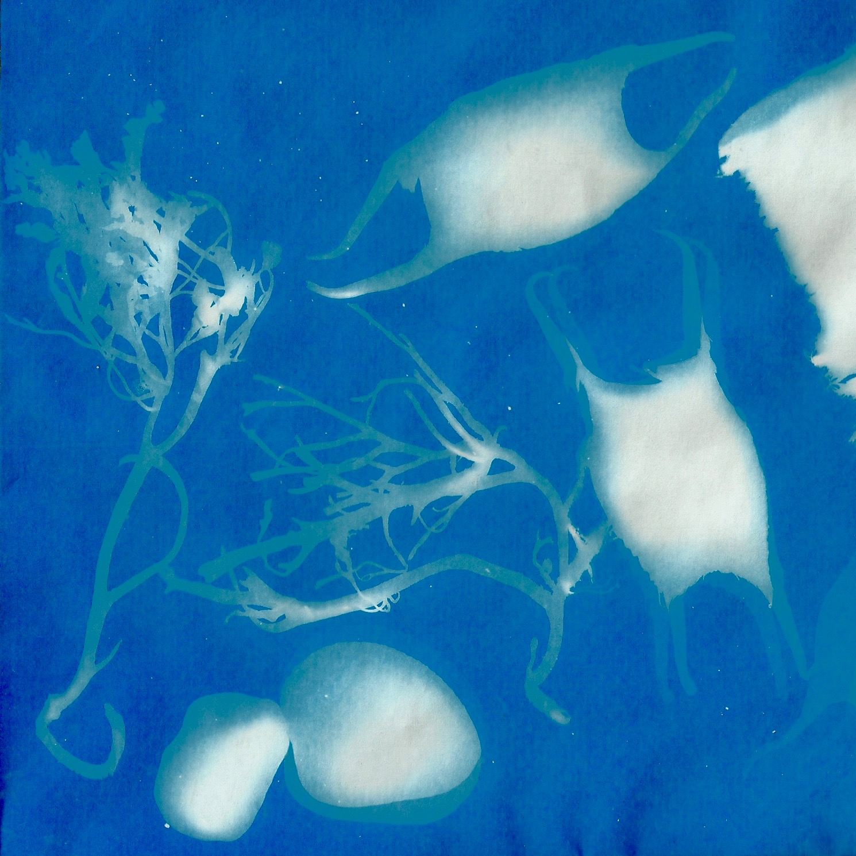
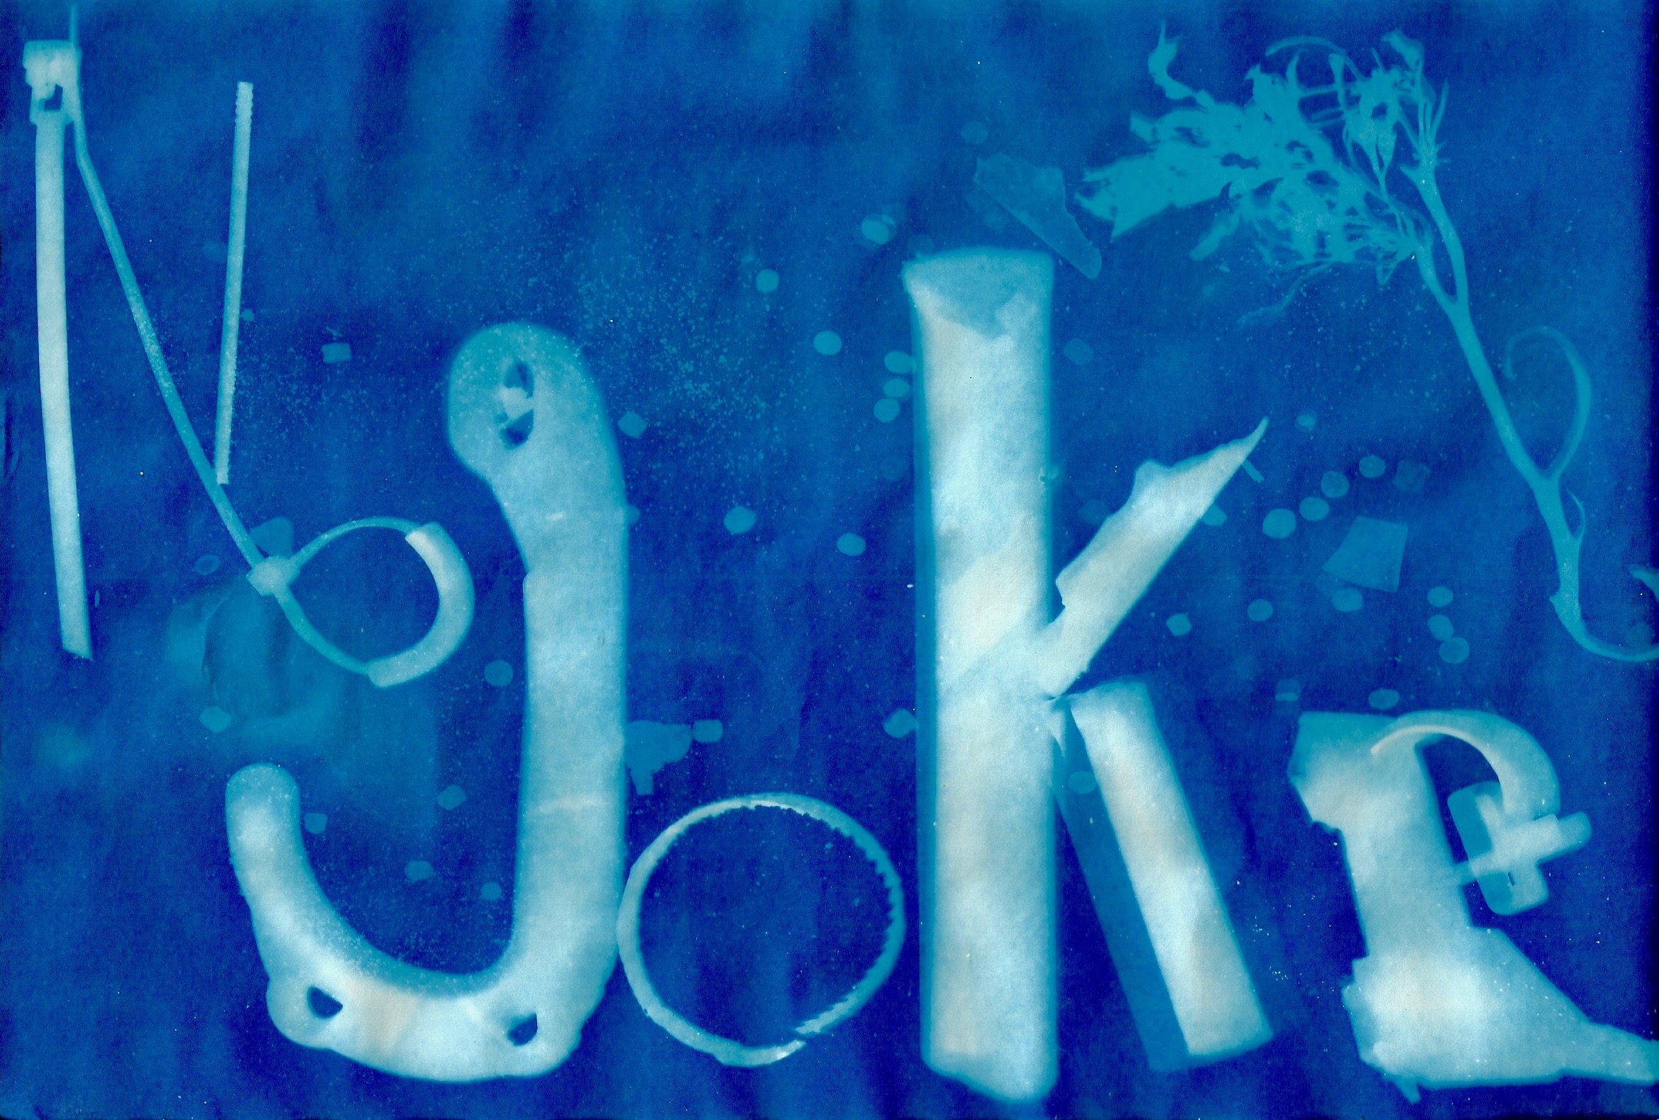

Slide 7
Scanner Photography
Design. Set out your items on an A4 sheet of paper and note their relative positions.
Place a blank transparency on the scanner glass or one that is a negative of your photo.
Arrange your items according to your design on top of the transparency.
Choose to leave the scanner lid up (especially if the items are large) or use card or coloured sheets or fabric placed over your items.
Make sure the scanner is linked to the computer and start scanning.
During scanning you may use a torch or move the coverings to obtain different effects.
Save the image on the computer.
Use a program to crop, and adjust contrast and colour.
Print the image.

Slide 8
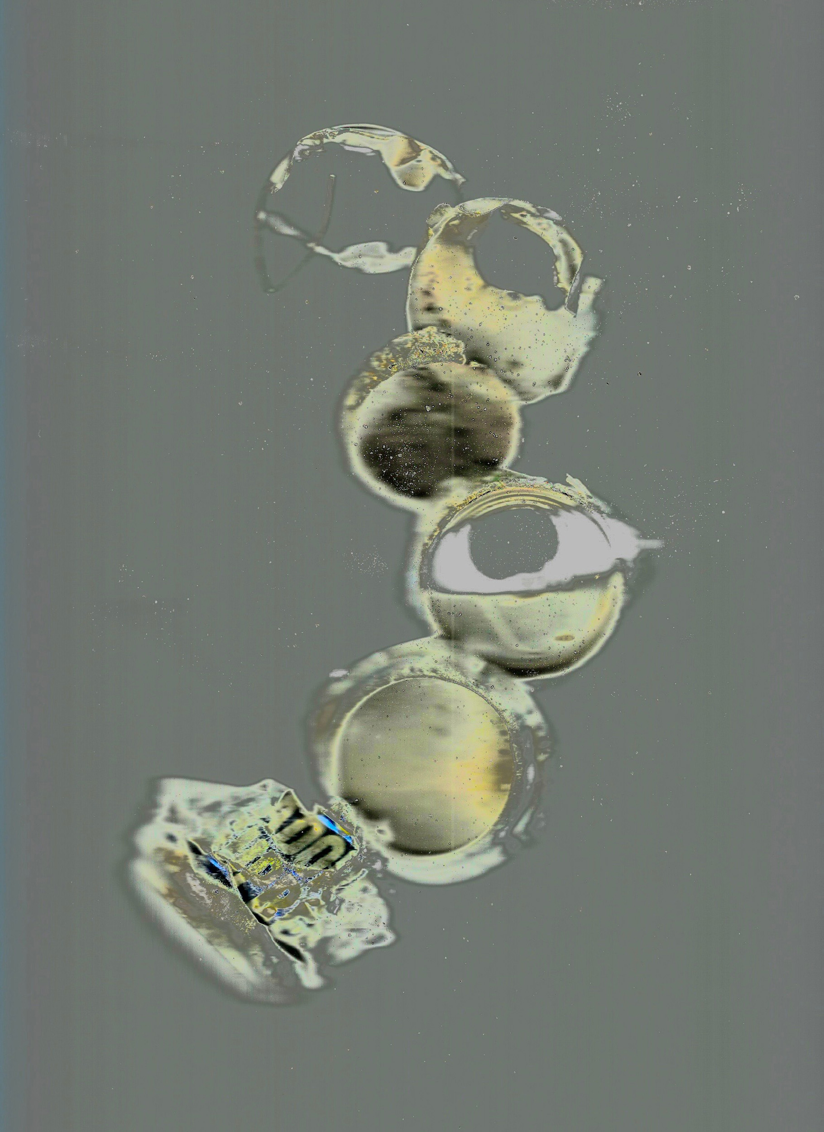
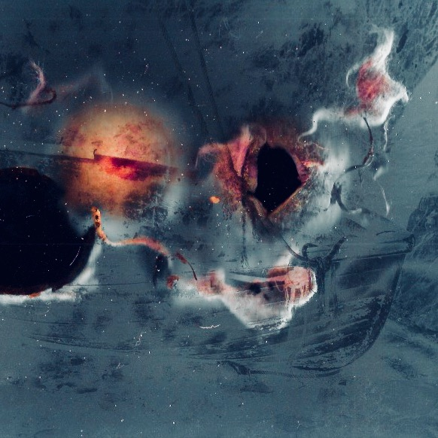

Slide 9
Information
Flights of Fancy Pinhole Photography Available at: https://www.amazon.co.uk
Cyanotype Kits, Supplies and Lamps. Available at: http://cyanotype.co.uk/
Super Sunprint Kit Make photographic type prints using sun and water Available at: https://www.amazon.co.uk
Lewis, William. 2018. Tower Bridge on a bright sunny day taken using a matchbox camera. Published by BBC News online Your pictures: Pinhole photography 3 May 2018. Available at: https://www.bbc.co.uk/news/in-pictures-43989507 [accessed 02-08-2018]
Images 1, 3, 4, 5 6 & 7 ©Sarah Newton

